Slide 1

Overview and Tools
CS 202 - Andrew Krause

Slide 2

What is REACT?
REACT is a JavaScript library used for building out user interfaces. It is a front-end framework in web development.
REACT is one of the most used front-end development technologies in the world.
Makes it easier and faster to build beautiful user-interfaces.
The technology was developed by Facebook in May of 2013.
Easy creation of dynamic applications, improved performance, reusable components, and can be used for web and mobile apps.

Slide 3
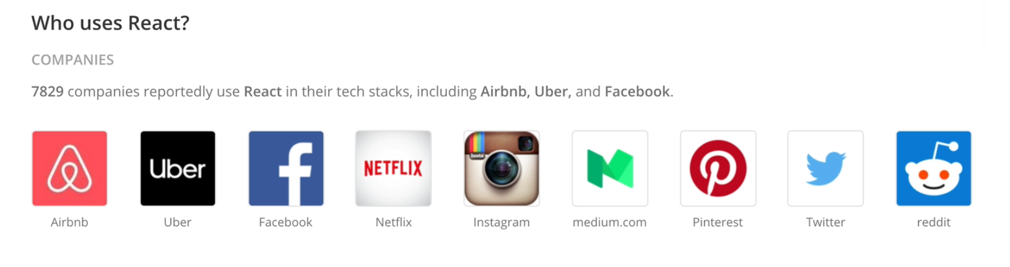
Why is REACT Important?
There are many large companies that use REACT including Airbnb, Uber, and Facebook.
REACT helps to optimize speed in the rendering of elements/components in the browser.
The technology only changes parts of components that need to be changed as opposed to reloading everything, which reduces loading speed.

Slide 4
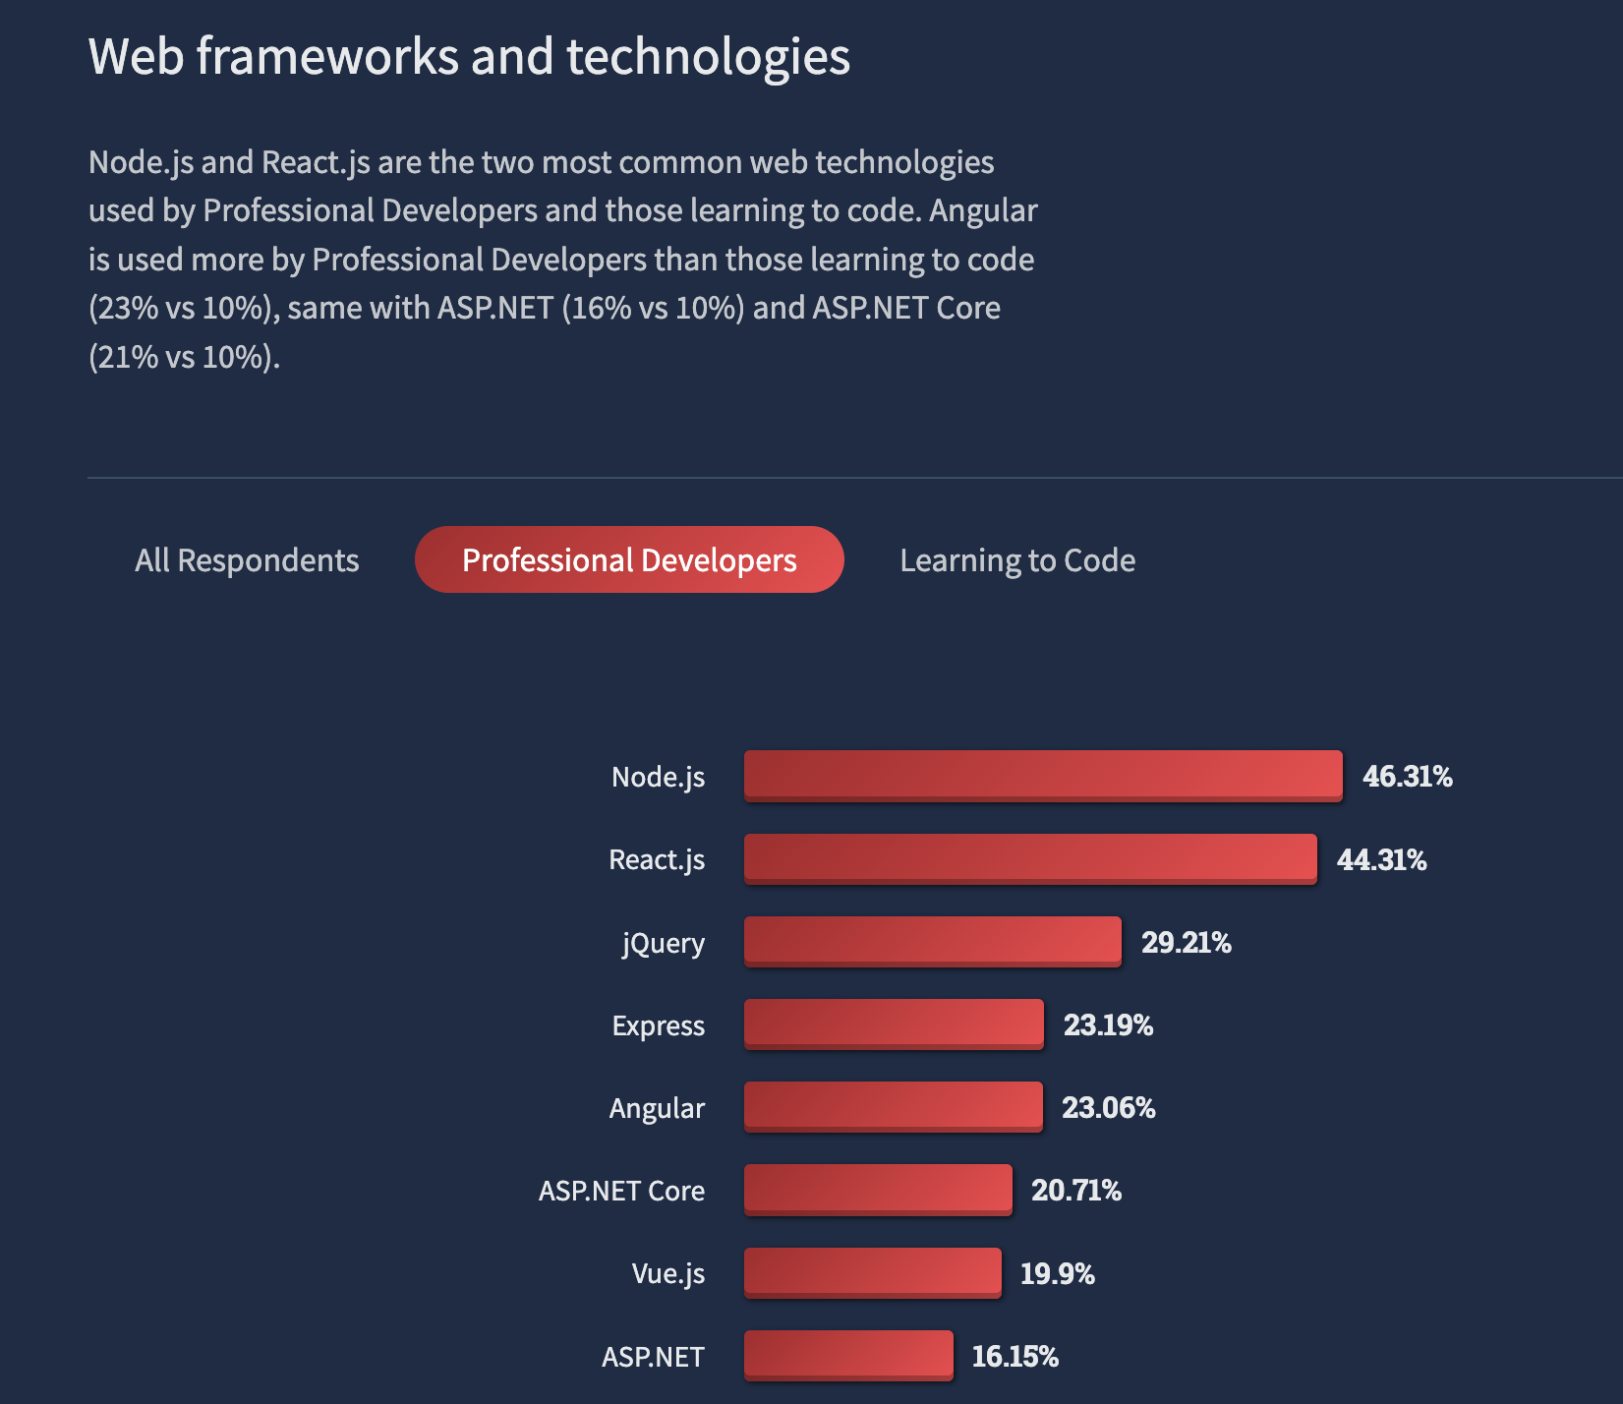
2022 Stack Overflow Developer Survey
REACT is a web technology used commonly by professional developers.
It is one of the most popular technologies, second only to Node.js.
Important to note that Node.js is used for the backend of web development while REACT is used for the frontend. You can use the two together in some cases.

Slide 5
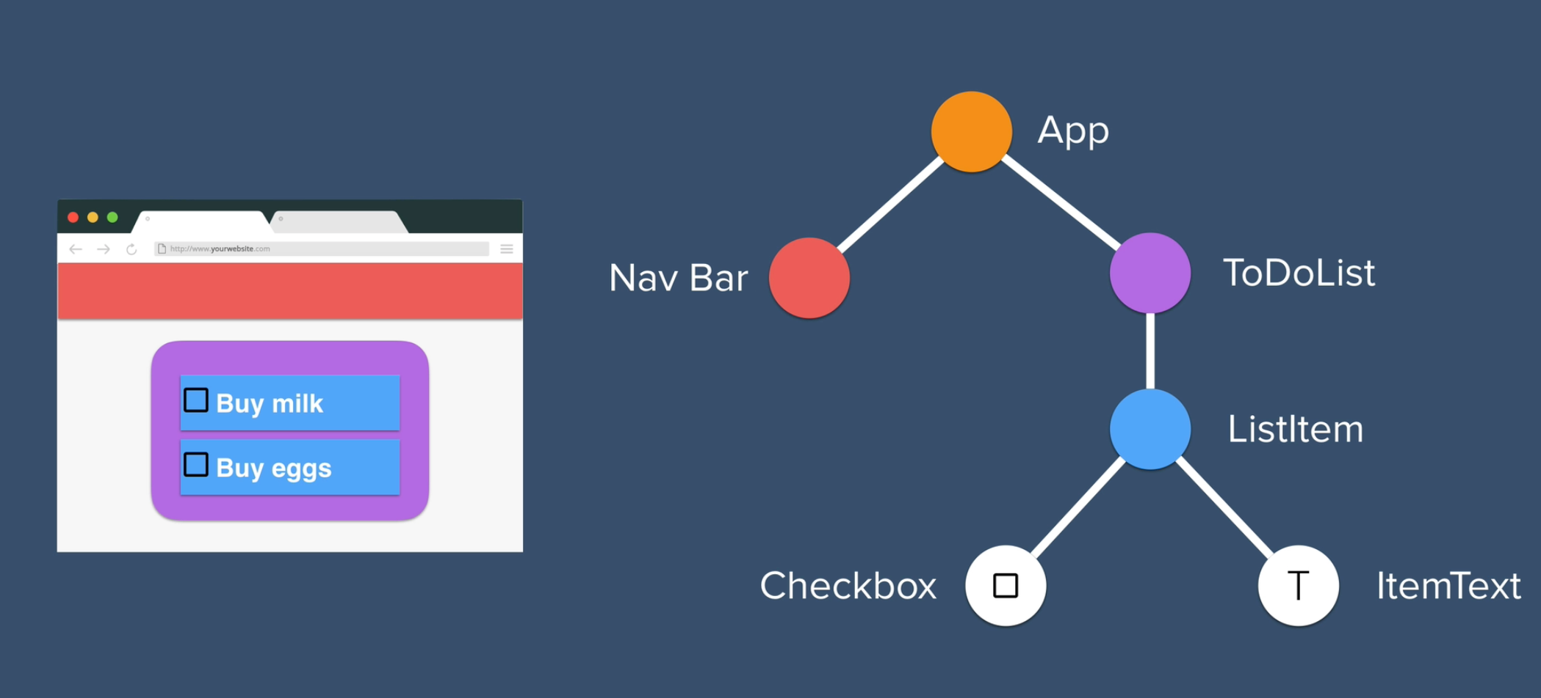
How does REACT work?
REACT breaks down a complex user-interface structures into a component tree.
This can be observed by the REACT dev tool extension in browsers like Chrome (more details later).
Basic idea is to code less and create more amazing user interfaces with REACT.

Slide 6
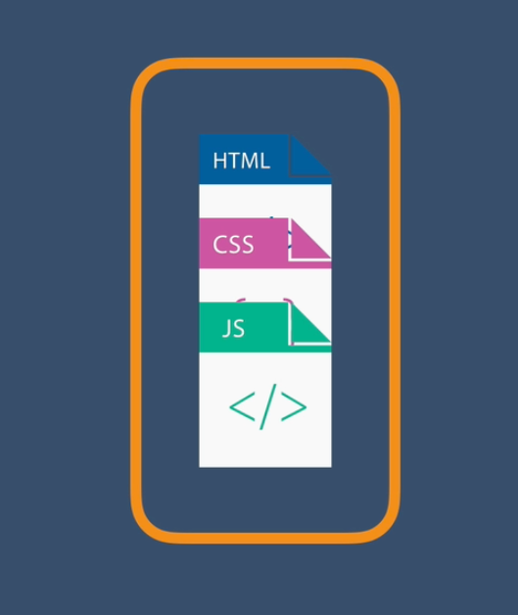
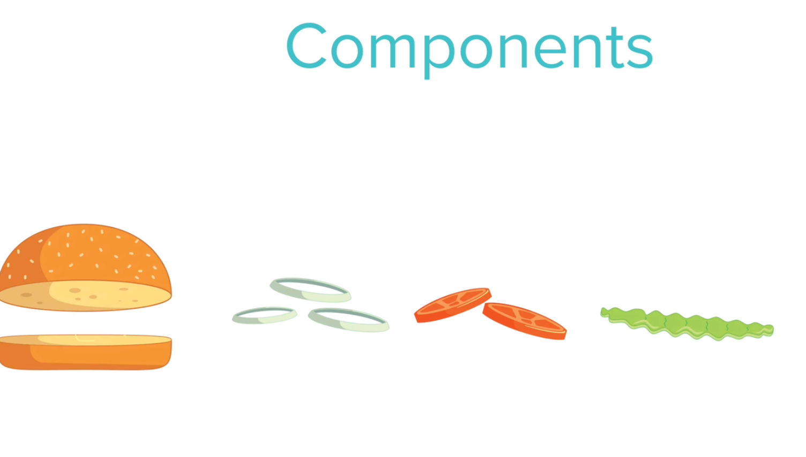
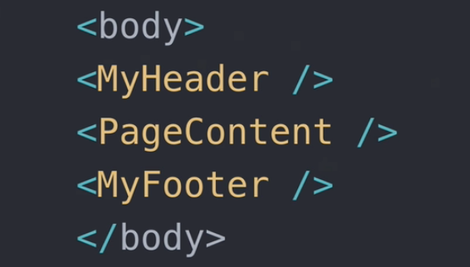
REACT Components Analogy
REACT enables you, in a way, to create your own custom HTML elements.
Each component can perform a different function and have a different appearance.
A way to think of REACT components us as different ingredients for a burger.
These ingredients can be modified and arranged however you want.

Slide 7
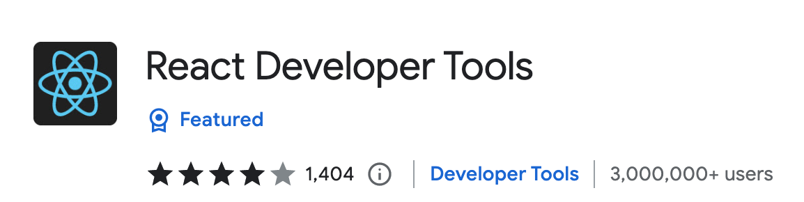
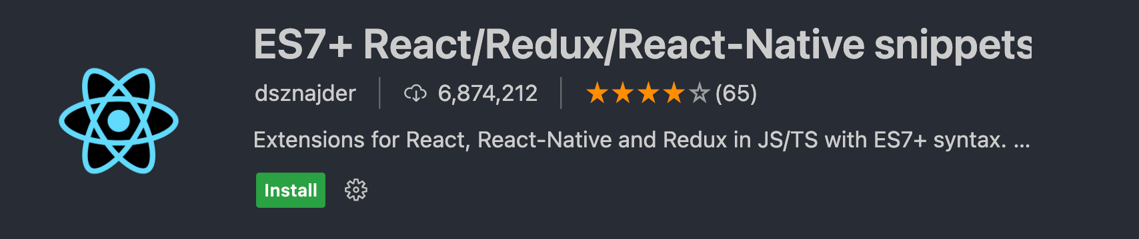

Tools for REACT
Chrome Browser Extension
REACT Tool Browser Extension (Chrome).
REACT Extension for the VS Code IDE.
CodeSandbox for practicing REACT without having to worry about installing dependencies.
VS Code Extension
Code Sandbox Tool Online

Slide 8
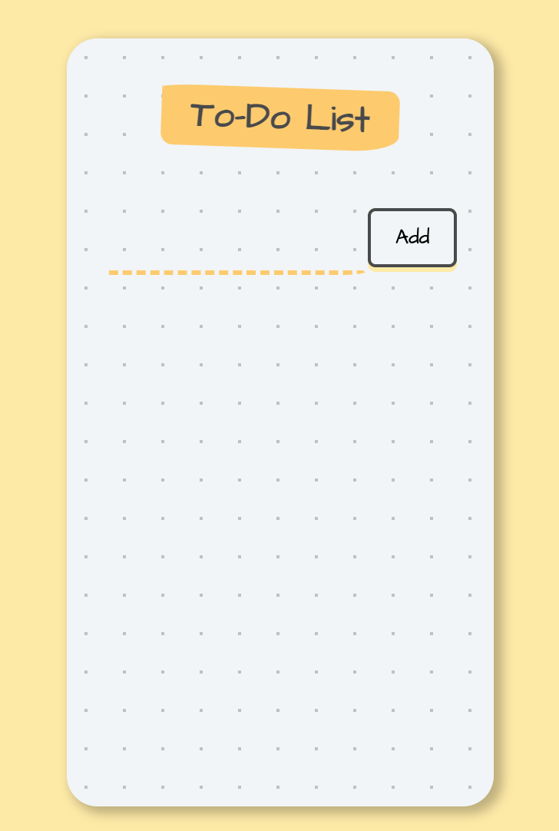
Example of REACT with CodeSandbox and Chrome REACT Tool Extension (Show briefly but focus more on example in VS Code on next slide).
In Google Chrome, show simple REACT project in CodeSandbox.
Open browser window for CodeSandbox project.
Observe the project and its components using the REACT tool extension in the Chrome Browser.
Show same process for the REACT project on your local computer, which is on the next slide. →

Slide 9
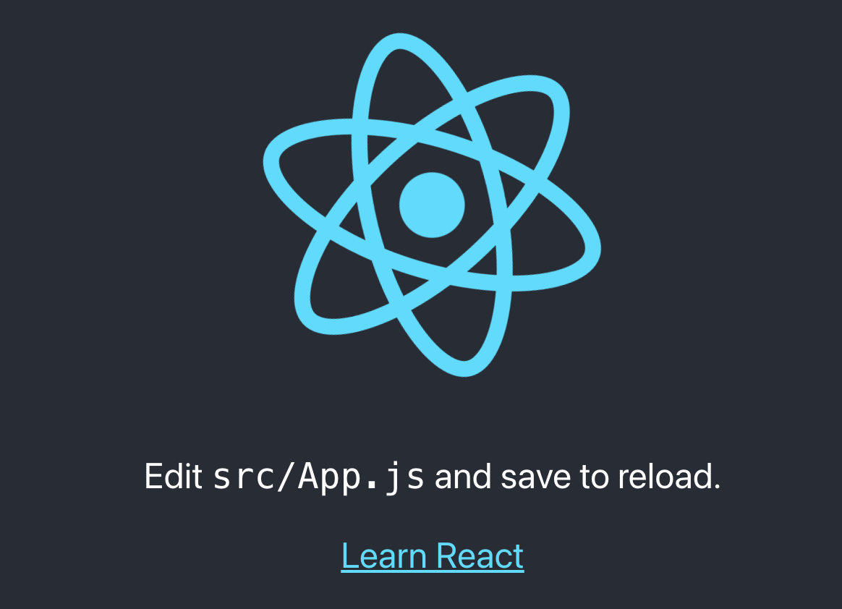
REACT Project Example
Make sure npm is installed on your system (run npm –v). If npm is not installed, then install it.
After npm is installed, run the command: npx create-react-app <NAME-OF-PROJECT> --use-npm (Should get a message in the end of the install like: We suggest that you begin by typing: cd <NAME-OF-PROJECT>, then npm start at the end of the project initialization).
If you run npm start, react will open the project (usually on localhost:3000) in your browser. Make sure you click any Allow Access buttons for any prompts that pop up for REACT.
You can begin editing your project from that point on.
(Show working example).
What you will usually see when you open your REACT project in your browser for the first time.

Slide 10



Learning Resources for REACT (Type bolded text into your browser for more info)
GitHub REACT Tutorial: https://github.com/iamshaunjp/Complete-React-Tutorial
Udemy REACT Courses: https://www.udemy.com/course/the-complete-web-development-bootcamp/learn/lecture/17038306#overview
REACT Documentation: https://reactjs.org/docs/getting-started.html
Maybe in the CS 402 course at UWL?

Slide 11

References and Sources
Udemy: https://www.udemy.com/
React Documentation: https://reactjs.org/docs/getting-started.html
CodeSandbox: https://codesandbox.io/
GitHub: https://github.com/

Slide 12
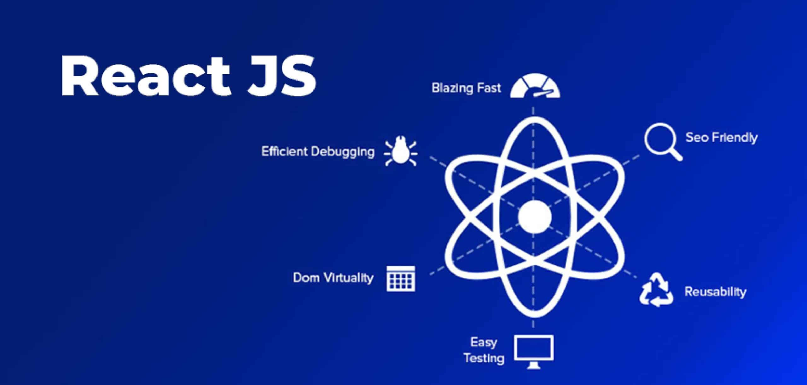
END – Thank you for your time

Slide 13

Any Questions?

